Slide 1
DIFFERENT TYPES OF MEDIA NETWORK
What is the media network?
A media network is a group of different types of media outlets (television, radio, newspapers, magazines, etc ). That distribute information, news, entertainment, and other types of content to the general public.

Slide 2
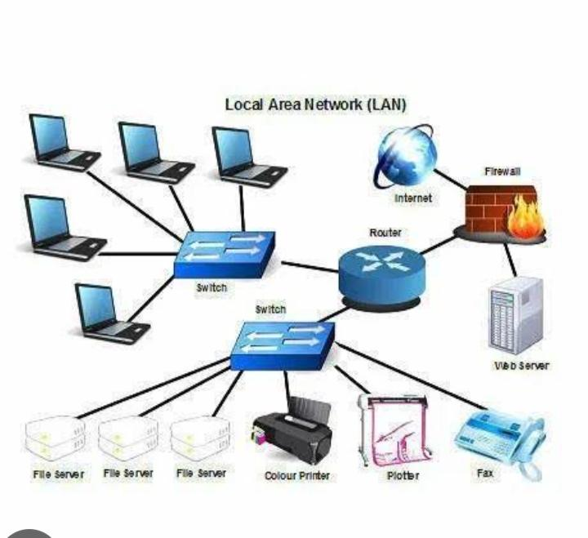
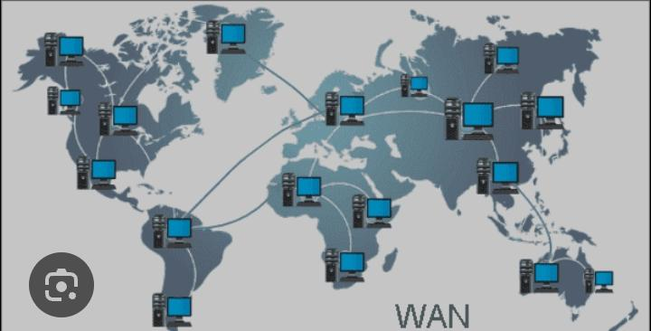
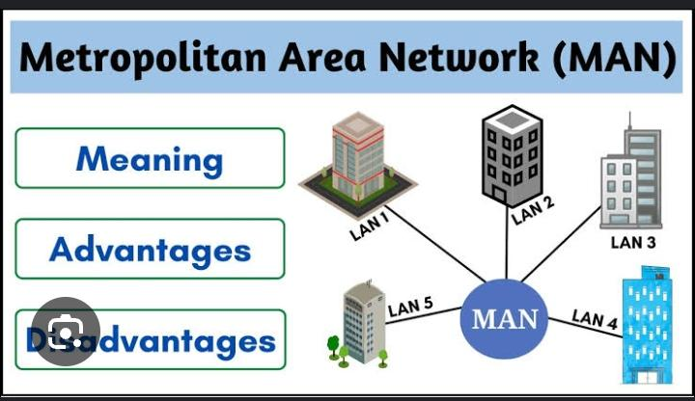
What are the 3 main types of media network?
The Network allows computers to connect and communicate with different computers vai any medium. LAN(Local Area Network), MAN(Metropolitan Area Network), and WAN(wide Area Network ) are the Three major types of networks designed to operate over the area they cover.

Slide 3
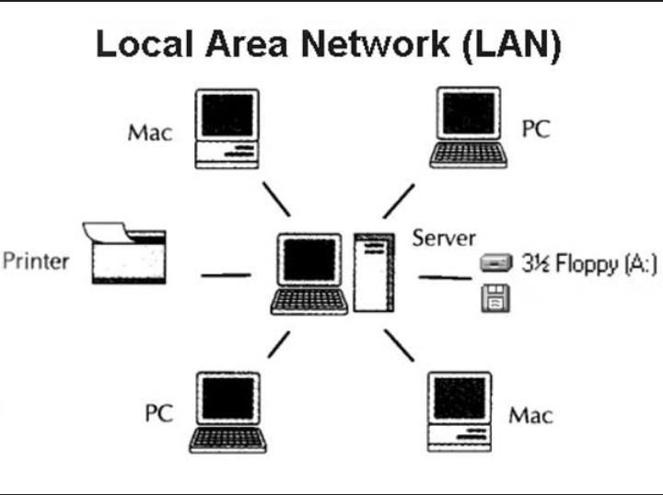
LAN(Local Area Network):-
A Local area network (LAN) is a network where several devices are connected in one physical location such as buildings, offices, homes, etc. Although it may sound simple, the LAN may feature a challenging layout with multiple types of cables, switches, routers, access points, and several other components.

Slide 4
MAN(Metropolitan Area Network):-
A Metropolitan Area Network (MAN) is a type of computer network that spans over a metropolitan area, typically a city. It provides high-speed data communication services such as video, audio, and data transfer between multiple LANs (Local Area Networks) and WANs (Wide Area Networks).

Slide 5
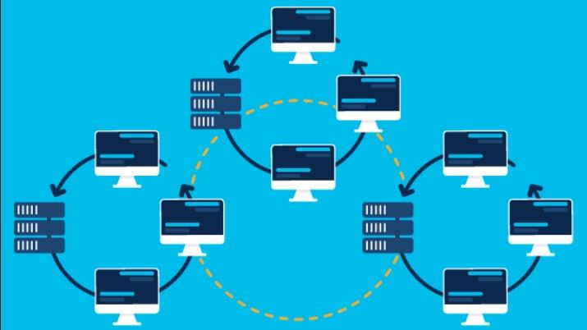
WAN(Wide Area Network):-
A wide area network (also known as WAN), is a large network of information that is not tied to a single location. WANs can facilitate communication, the sharing of information and much more between devices from around the world through a WAN provider.

